Slide 1




Team Details
Team name: Logic Makers
Team leader name: Deepak P M
Team size: 4

Slide 2
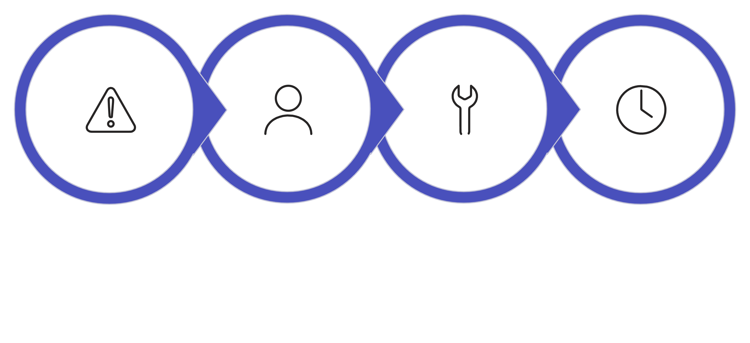
The Problem
Current Flaws
When critical machinery fails, engineers waste hours searching through siloed, 1,000+ page OEM manuals and scattered maintenance logs to find the root cause.
Relying on manual searches through unindexed PDFs, disconnected CMMS software, and the "tribal knowledge" of retiring veteran engineers.
Who Feels the Pain
The Business Impact
Maintenance Engineers, Plant Managers, and Reliability Teams working in manufacturing, oil & gas, and heavy industry sectors.
Unplanned downtime costs manufacturers tens of thousands of dollars per hour. Rapid troubleshooting is critical to preventing massive revenue loss.

Slide 3
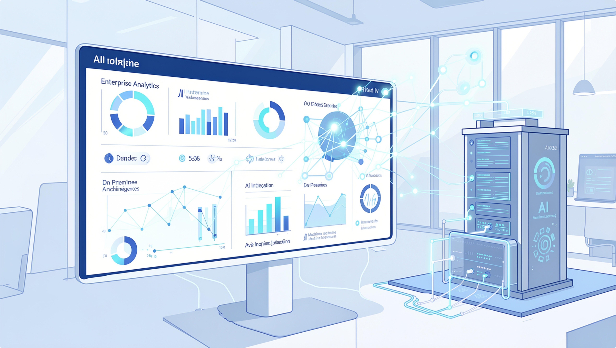
Centralized AI Intelligence Core
Industrial Brain utilizes local, on-premise Retrieval-Augmented Generation (RAG). It ingests unstructured PDFs and maintenance logs into a searchable vector database, allowing engineers to "chat" with equipment data naturally.
Automated Root Cause Analysis (RCA)
During anomalies, the system fetches exact historical citations from manuals and auto-generates RCA reports. Running on local hardware (e.g., AMD Radeon GPUs) guarantees 100% data privacy and protects trade secrets from public cloud AIs.

Slide 4

Ideal Customer Profile
Our core customers encompass high-stakes, capital-intensive environments where equipment reliability directly correlates with revenue:
▹
Heavy Manufacturing Plants
▹
Energy Sector Facilities (Oil & Gas)
▹
Automotive Assembly Lines
▹
Industrial Maintenance Contracting Firms
The market is growing rapidly as Industry 4.0 and predictive maintenance adoption accelerates.

Slide 5
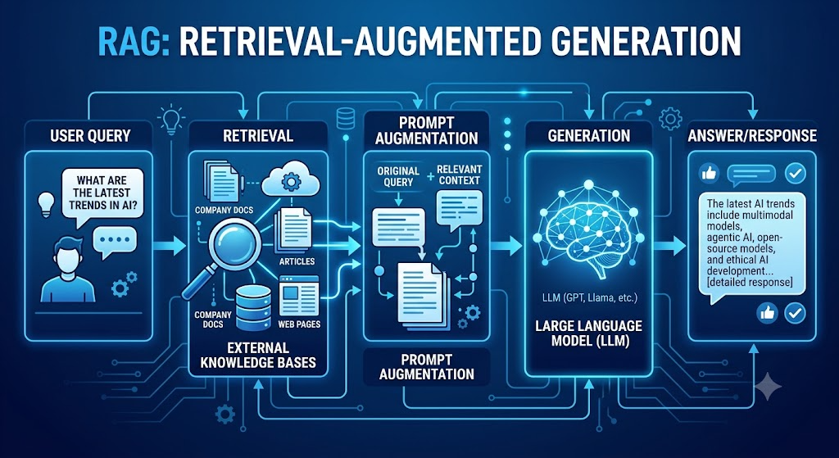
Revenue Model
Pricing Structure
Standard Mid-Sized Plant License
We operate on a robust B2B Enterprise SaaS (Software as a Service) subscription model.
This tier covers the indexing and active analysis of up to 500 individual industrial assets.
Pricing is tiered intelligently based on two primary factors:
The total number of indexed mechanical assets.
The volume of active engineering user seats.
We also offer custom enterprise pricing structures negotiated for multi-site global rollouts.
Includes a one-time on-premise installation and integration fee.

Slide 6

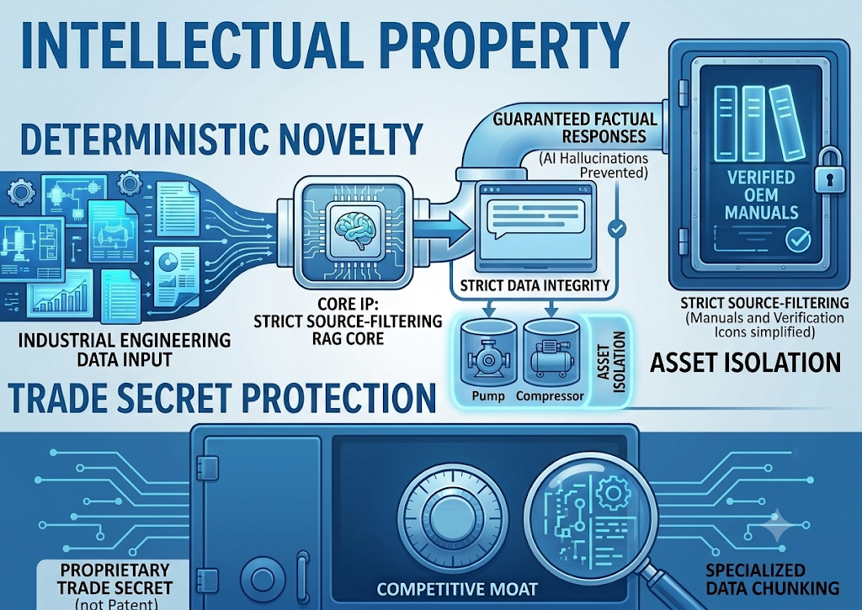

Prototype Ready
We have successfully built a fully functional web application prototype.
The architecture features a responsive React UI, a high-performance FastAPI backend, and seamless integration with localized LLM processing units.
TRL 6 Certification
Technology Readiness Level 6
Our system has moved beyond theoretical modeling. We possess a system/subsystem prototype successfully demonstrated within a highly relevant industrial environment.

Slide 7

Intellectual Property
Deterministic Novelty
Our core IP is a strict source-filtering RAG pipeline explicitly tailored for industrial engineering data.
It completely prevents AI hallucinations by binding answers strictly to uploaded OEM manuals and guaranteeing no cross-contamination of asset histories (e.g., preventing pump data from mixing with compressor data).
Trade Secret Protection
We are currently maintaining this architecture as a proprietary trade secret rather than pursuing a patent.
Our unique competitive moat lies within our highly specialized, domain-specific document chunking algorithm designed for mechanical schematics and logs.

